Slide 1
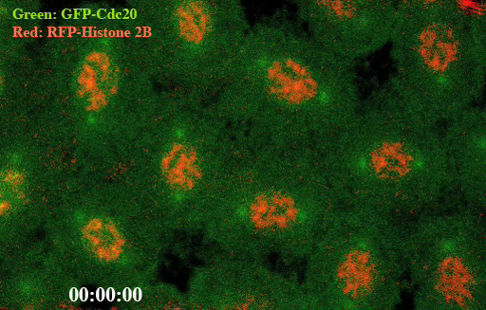
Individual cells in Drosophila (fruit fly) transgenic syncytial embryo were marked by GFP-Cdc20 fusion protein in green and RFP-Histone 2B fusion protein in red. The time-lapse movie showing the GFP-Cdc20 (Fzy in Drosophila) kinetochore recruitment and its dynamic distribution throughout the nuclear division cycle in a syncytial embryo. The RFP-Histone 2B chromosome signal used to indicate the dynamic of the chromosome (Huang’s lab).

Slide 2
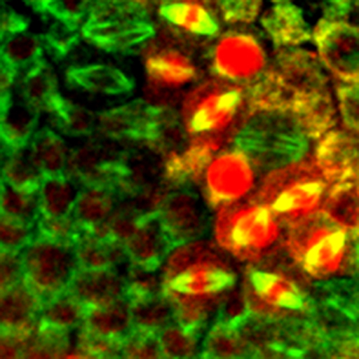
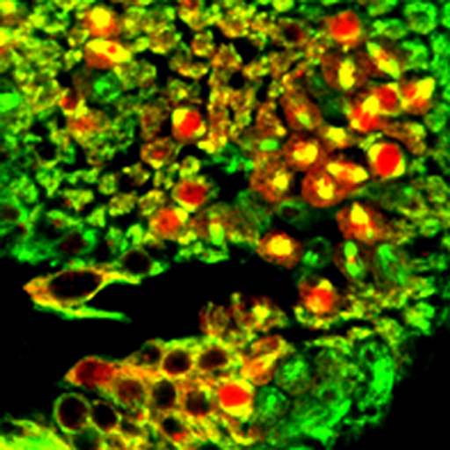
The behaviors of the Cyclin B (red) at different stages of the cell cycle (marked by microtubules in green) in late developmental Drosophila embryo (Huang’s lab)

Slide 3
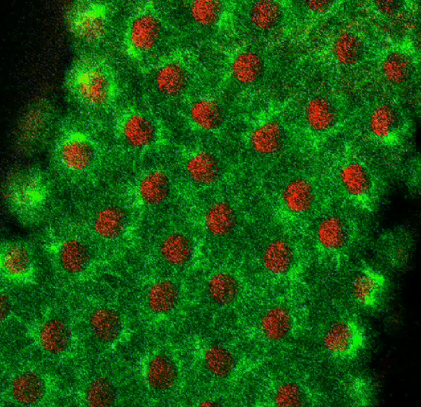
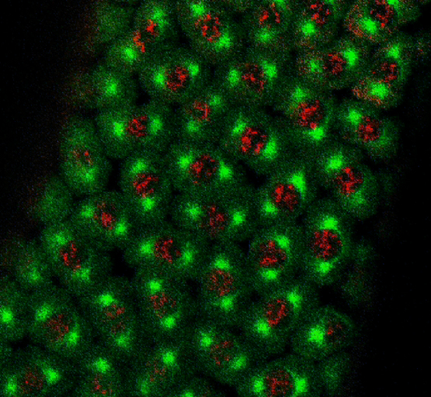
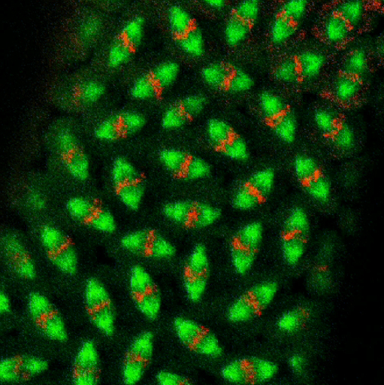
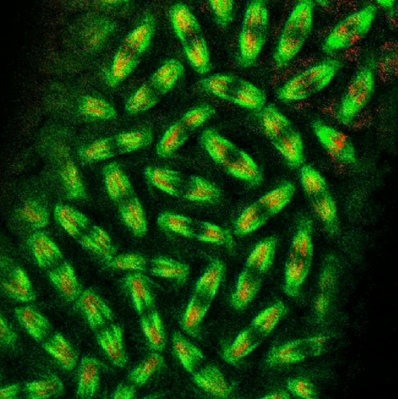
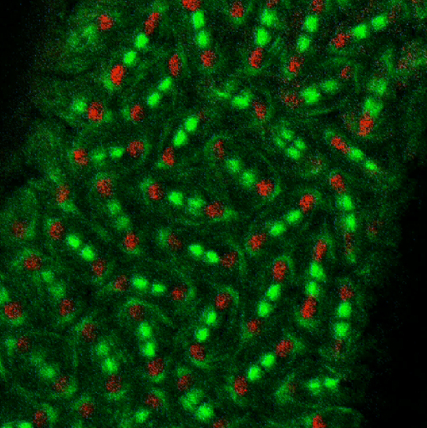
Interphase
Prophase
Metaphase
Anaphase
Telophase
Cell cycle progresses in Drosophila syncytial embryo. Red: Chromosomes; Green: Microtubules (Huang’s lab)

Slide 4
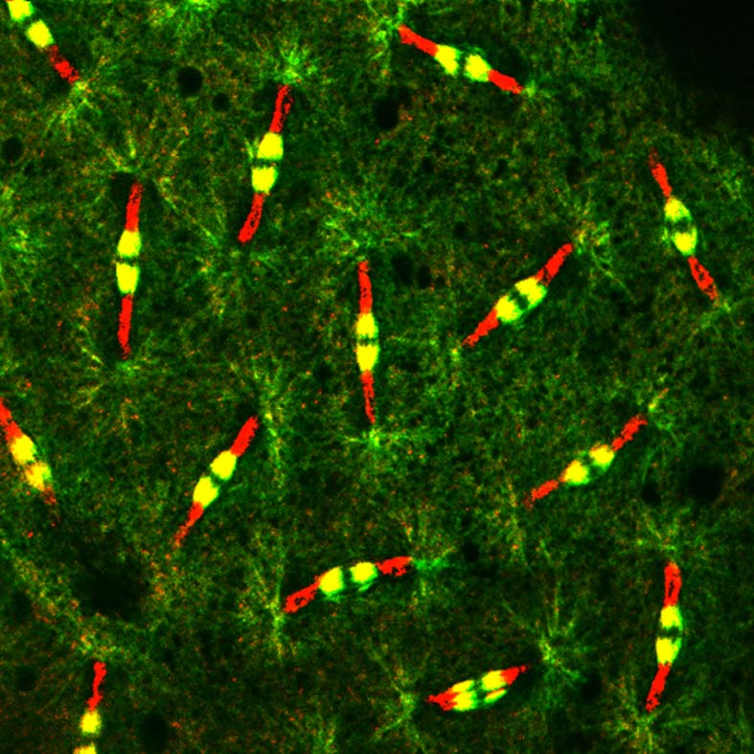
Christmas cracker: A confocal image taken from a small proportion area of a syncytial Drosophila embryo to show cell cycle in telophase. Red: a specific antibody stained on separated chromosomes as well as in the yellow region of the microtubule mid-bodies. Green and Yellow: Microtubules (Huang’s lab).

